Slide 1
Create a recipe from scratch
Step by step

Slide 2
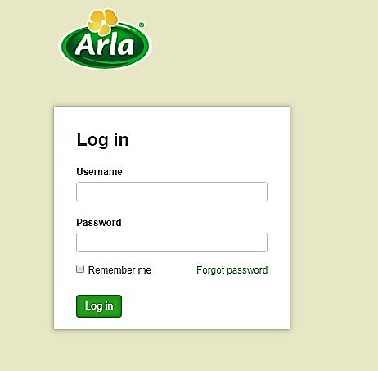
Step 1. Login to RDB
Open https://rdb.arla.com
Enter your login name and password, press Log in button

Slide 3
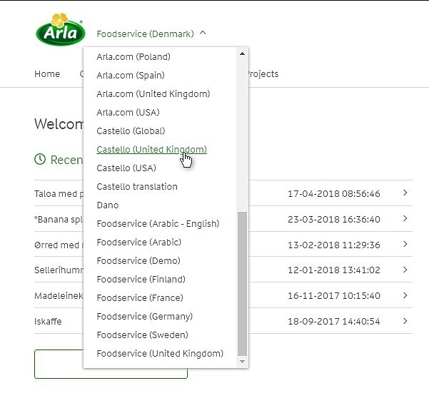
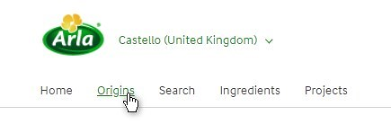
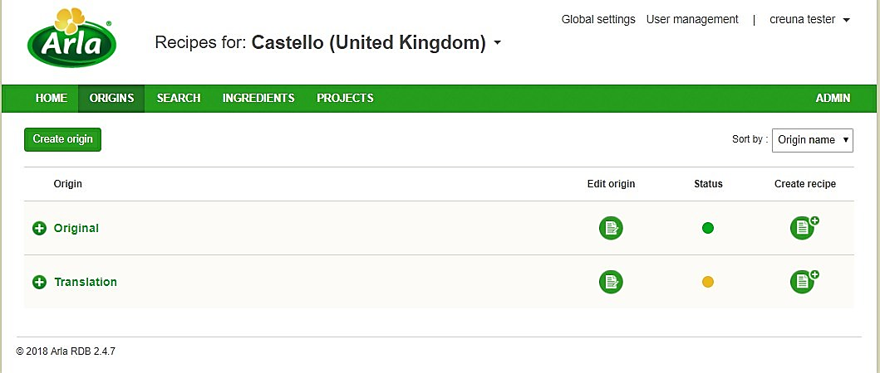
Step 2. Choose the Market, open Origins
Choose the market, where the new recipe will be created
Open the list of available origins, where the recipes are locating, by click on Origins link
Each origin could be treated as usual folder that contain recipes:
The Original origin contains recipes, that are created from scratch;
The Translation origin contains recipes, that were translated from another markets.

Slide 4

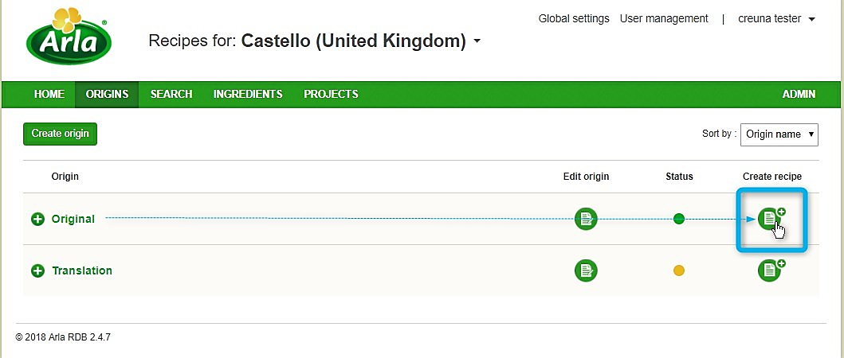
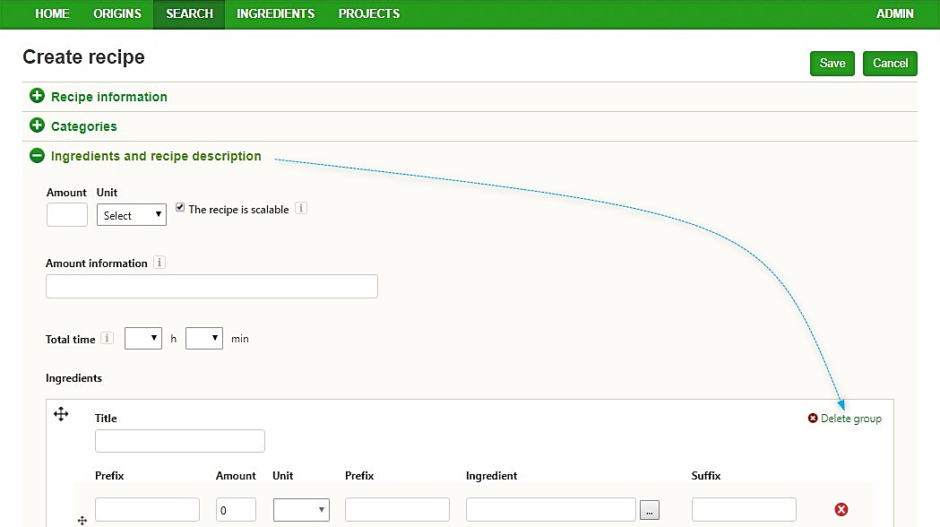
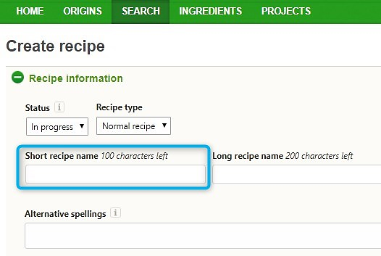
Step 3. Create recipe basis entering minimum required data
To start creating a new recipe click on Create recipe icon in front of name ‘Original’.
Expand Recipe information section and set Short recipe name
Expand Ingredients and recipe description section and delete the empty ingredients group.
Press Save button.

Slide 5
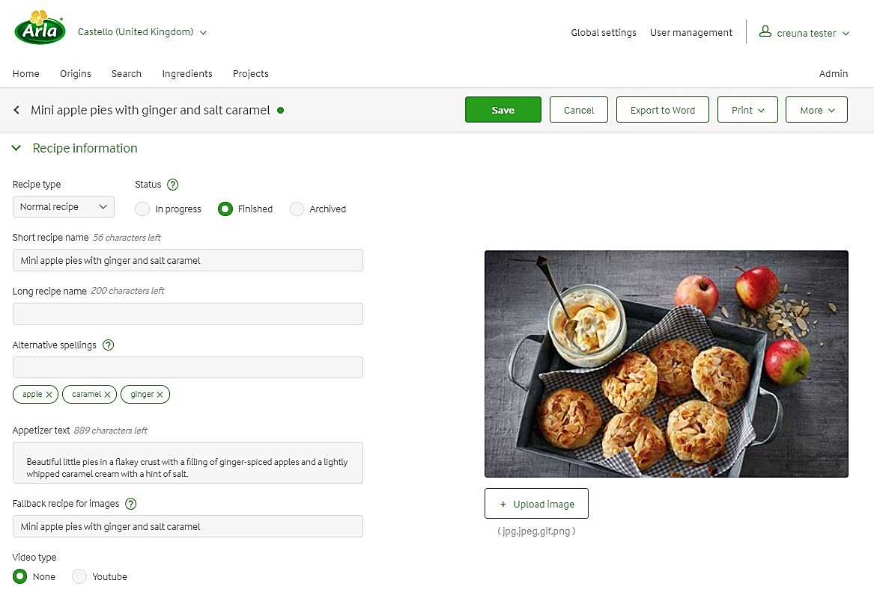
Step 4. Recipe information section
Some fields could be skipped as they are not in use on Castello website. So, fill in the following fields (they are also not mandatory, and could be left empty) :
Recipe type – Normal or Easy depending on total time preparation, but could be left Normal by default.
Status – In progress by default and it should stay In progress until the recipe is ready to be shown on the website. When everything is done, the status should be changed to Finished.
Short recipe name – is already filled out (in previous step).
Alternative spellings – put the keywords by which the user could find the recipe using search on the website. Type the keyword and press ENTER, do so word by word.
Appetizer text – shown on the recipe page as an intro to the recipe.
Upload image – the image is represented on the recipe page and it can be specific for different markets.
Fallback recipe for images – if the image is not uploaded, then editor can specify the recipe from where the image could be shown. By click in the field choose the fallback recipe.
Video type – None by default. If the video should be added please click Youtube and put the video ID to the appropriate field (f.e. if the full link is https://www.youtube.com/watch?v=Z1ssscoMRi4 , then the video ID is Z1ssscoMRi4)
Don’t forget to Save your changes.

Slide 6
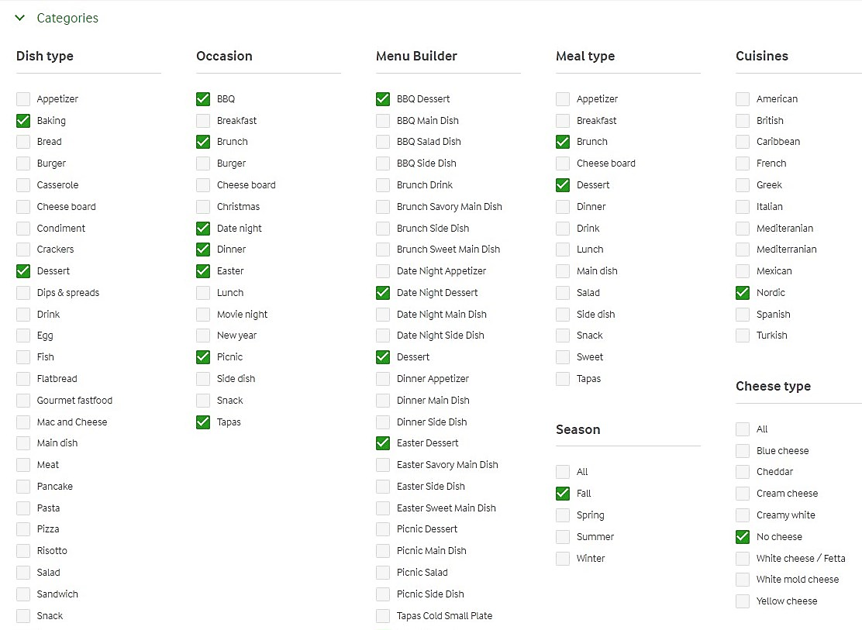
Step 5. Categories section (Tagging)
Specify which categories the recipe matches.
Occasion, Meal type and Cheese type are used on the Recipe Overview page as a filters.
The rest of categories are used in Menu Builder functionality
Save your changes.

Slide 7
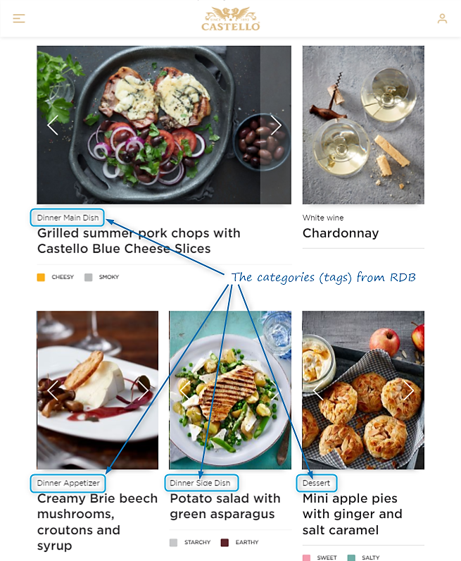
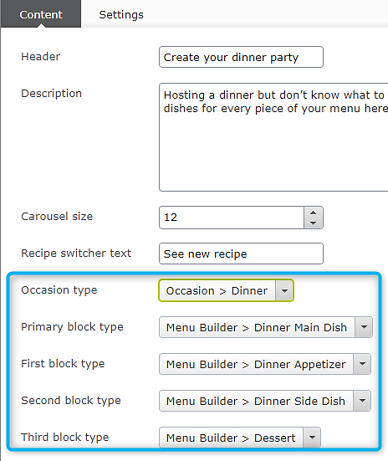
Menu builder tagging
On the website the Menu Builder looks like this:
In Episerver it is building in the following way:
In the dropdowns editors can specify the Occasion type, the Primary block type and three secondary block types. All the categories are taken from RDB.
The system automatically picks from RDB the recipes with chosen appropriate categories.
So f.e. for Primary block there will be represented recipes with chosen Dinner Main Dish category. And for the First (left) block it will be shown the recipes with chosen Dinner Appetizer category and so on.

Slide 8
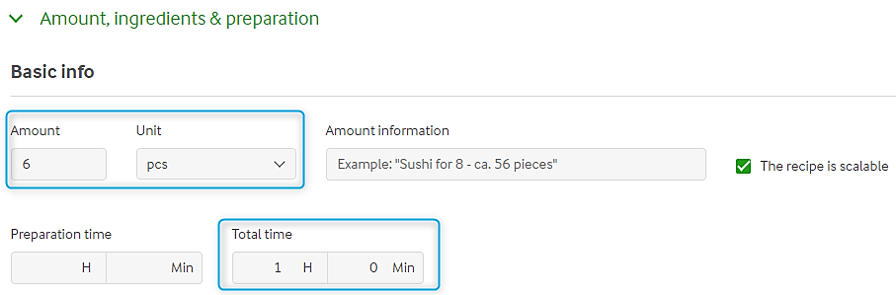
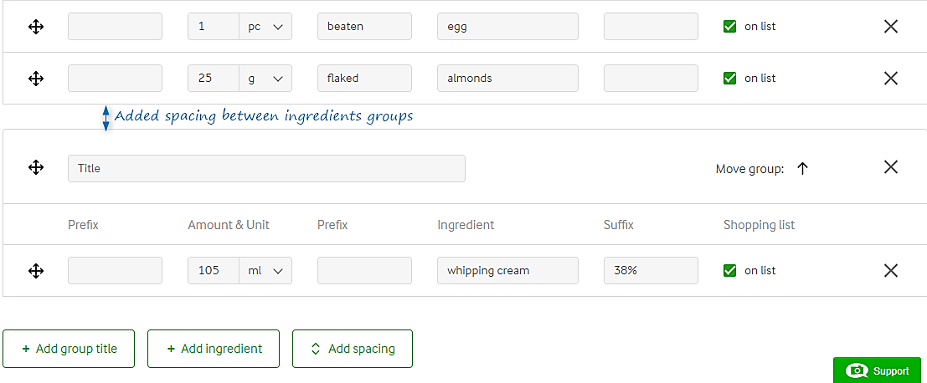
Step 6. Amount, ingredients and preparation section
Fill the following:
Basic info:
Amount, Unit and Total time
Ingredients and recipe description:
To Add the ingredient click on Add ingredient button;
To separate one ingredients group from another, click Add spacing button.
To add the ingredients group titles click Add group title.
How to add ingredient:
Click on Add ingredient button – the ingredient line has appeared;
In Ingredient field start typing the ingredient name and in the autosuggestions list pick the right ingredient – the cursor will jump to Amount & Unit field automatically;
Put the amount of the ingredient and measurement units;
Prefixes and Suffix parts are needed to build the readable sentence (not mandatory).
Check that cheese names are starting with capital letters, e.g. Mature Cheddar
Don’t forget to Save your changes time to time.

Slide 9
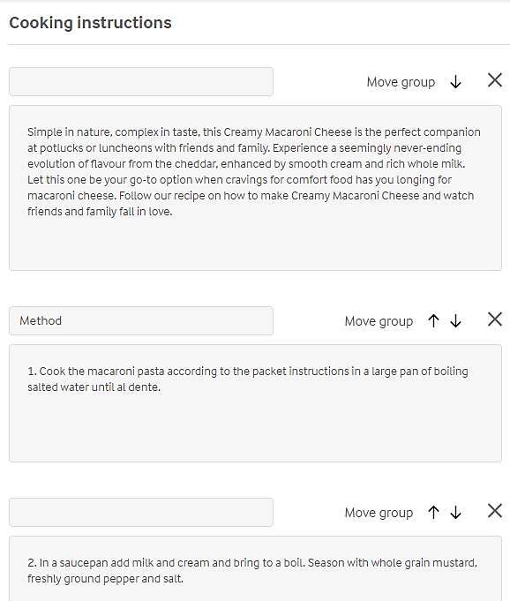
Step 6. Amount, ingredients and preparation. Cooking instructions
Cooking instructions:
the first cooking instructions section goes as an intro to the preparation process;
each step of the recipe should be created in its own group and that it should be numbered;
the cooking instructions titles are not shown on the website, so they could be skipped;
right after the list of instructions the additional groups could be added also.
See example here: https://www.castellocheese.com/en-gb/recipes/creamy-macaroni-cheese/

Slide 10
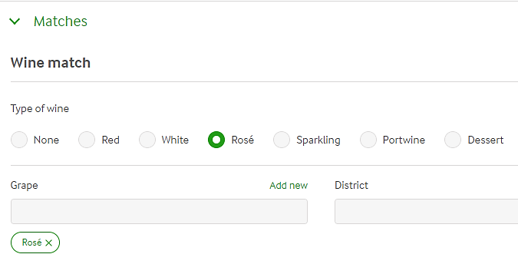
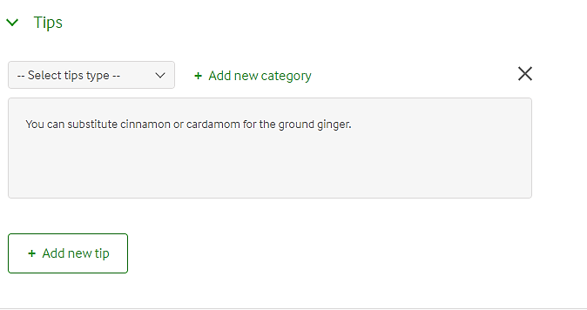
Step 7. Matches, Serving Tips
In Matches section specify the Type of wine that matches the recipe and the Grape. This data is used in Menu builder functionality.
Don’t forget to Save your changes.
In Tips section put the Tips and Tricks for preparation the dish.
Important: even though editor is not restricted in number of Tips groups, never the less only the first Tips group will be shown on the Recipe page.

Slide 11
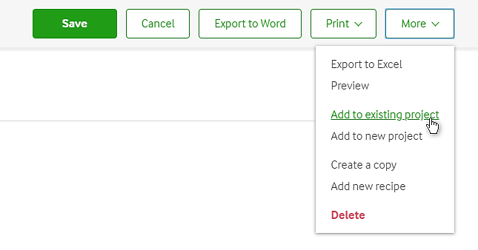
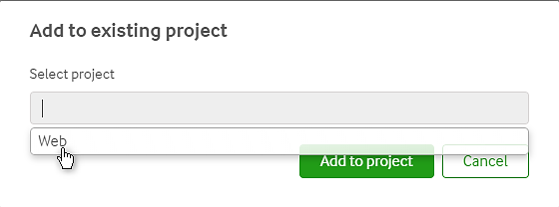
Step 8. Add recipe to existing project and Publish
When all the data is in place and the recipe is ready to be published, meaning shown on the website, we need to add it to existing project called Web.
For that in the sticky main menu click on More and choose Add to existing project
Right after the recipe was added to the project Web, go to the Recipe information section and change the recipe status from In progress to Finished and press Save button.
Well done! The recipe is completed and shown on the website.

